Slide 1
Trucking Risk Analysis Using Spark
Submitted by :
Pranav Sheth (810028118)
Dev Patel (828593772)
Prof: TSENG-CHING JAMES SHEN

Slide 2

Table of Content
Problem Statement
Objective
Data Workflow
Implementation Approach
Discussion on Results
Conclusion

Slide 3
Problem Statement
TRUCKING
Challenges in effectively ensuring and enforcing compliance among all drivers within the fleet poses a significant threat to the company's operational efficiency, financial stability, and overall reputation.
C O M P A N Y

Slide 4
Objectives
Implement measures to enhance driver safety, reduce accidents, and minimize associated costs such as insurance premiums and vehicle repairs.
Increase revenue generation and optimize cost-effective operations to enhance overall profitability in trucking operations
Streamline processes, improve resource utilization, and reduce downtime to enhance operational efficiency and minimize associated costs.
TRUCKING
C O M P A N Y

Slide 5
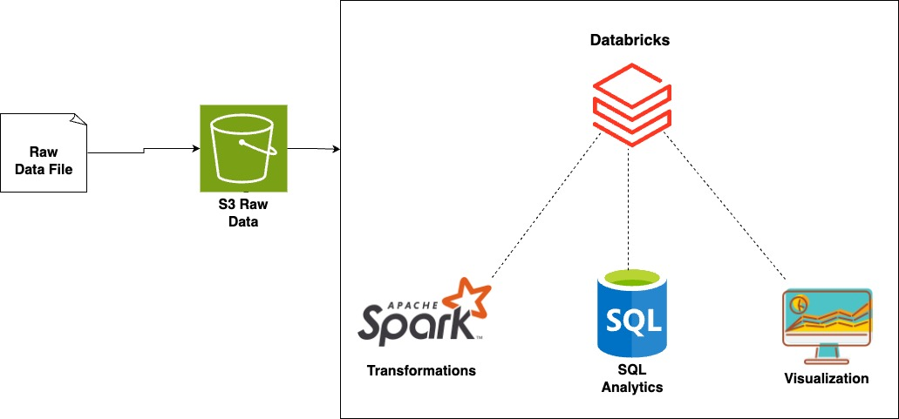
Data Workflow

Slide 6
Implementation Approach
Data Ingestion:
Raw Data Storage: Data is initially fed into an AWS S3 bucket. This involves storing raw trucking data such as mileage, gas usage, geolocation, events, and driver specifics in a structured CSV format.

Slide 7
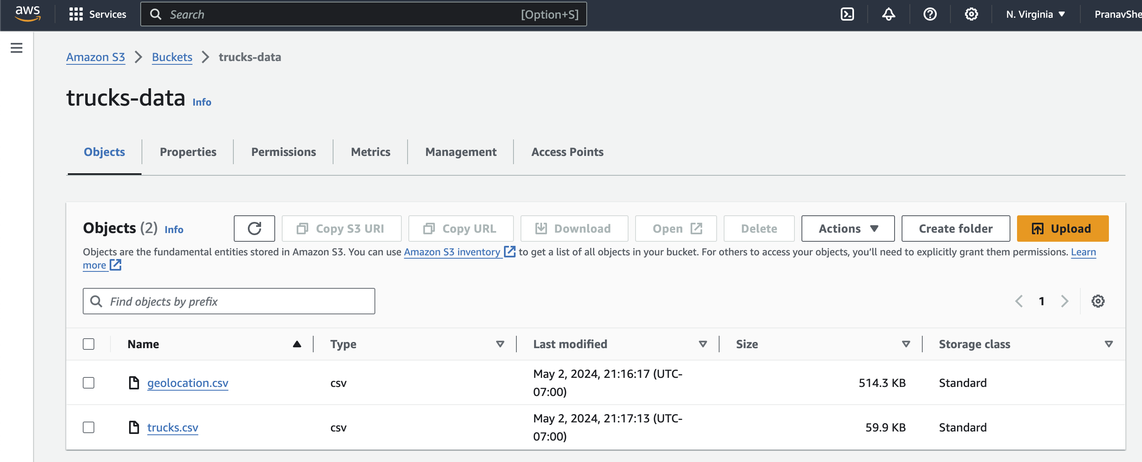
Implementation Approach

Slide 8
Implementation Approach
Data Processing and Transformation :
Spark Session Initialization: Establish a Spark session named "Trucking Risk Analysis" using Databricks to enable data manipulation and analysis capabilities.
Schema Definition:
Truck Schema: Dynamically define a schema that includes fields for driver ID, truck ID, model, and detailed monthly data on mileage and gas spanning from January 2009 to June 2013.
Geolocation Schema: Define a schema for geolocation data that includes fields for identifying truck and driver details, event types, velocity, event indications, and idling indications.

Slide 9
Implementation Approach
Data Exploration: Display initial rows from the loaded Dataframes to verify the data structure and integrity.
Data Loading: Load the data from the S3 bucket into Spark Dataframes according to the predefined schemas using the CSV format. This includes separate Dataframes for trucks and geolocation data.

Slide 10
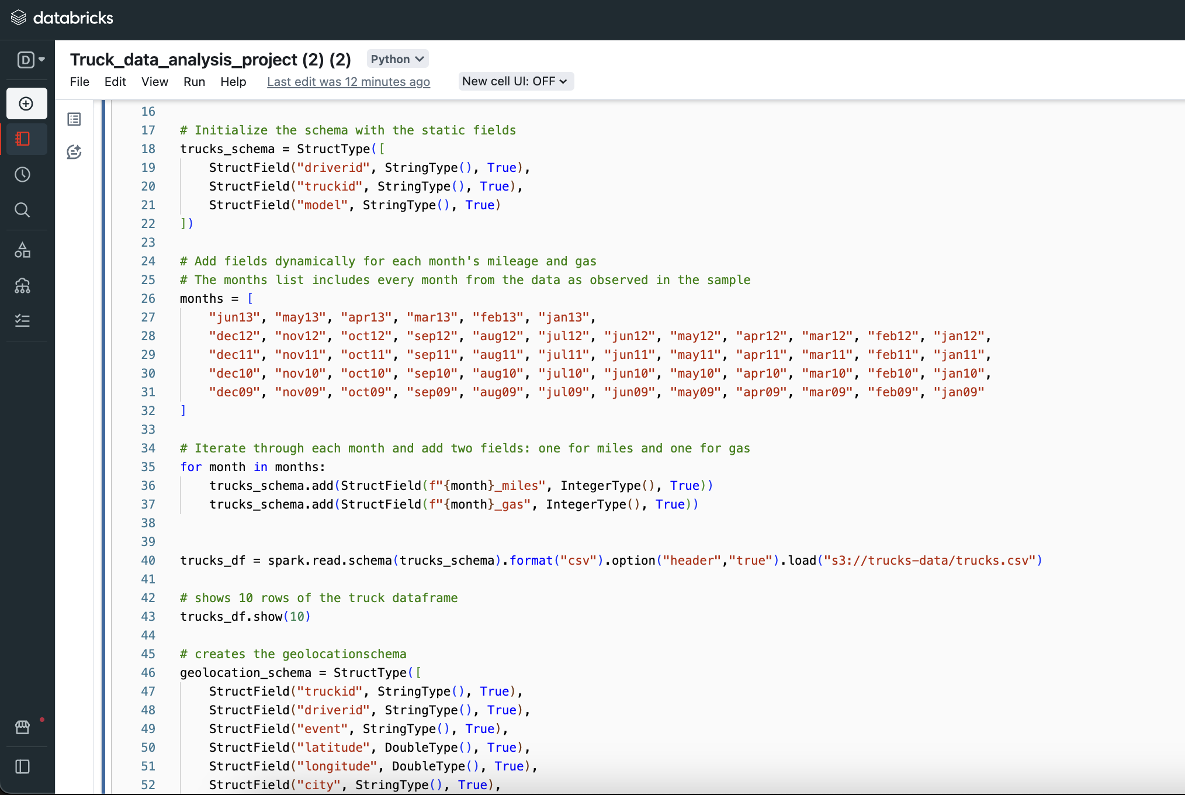
Implementation Approach

Slide 11
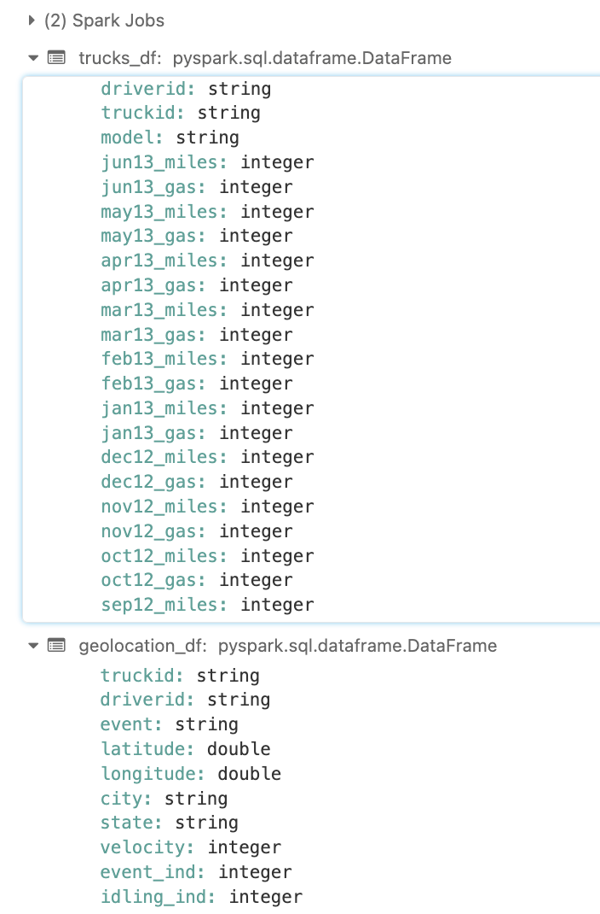
Implementation Approach

Slide 12
Implementation Approach
Data Transformation Using PySpark
Event Analysis:
Extract and filter data for each driver to analyze events other than normal operations.
Group by event types to count occurrences for each driver, which helps in identifying frequent anomalies or risky behaviors.
Risk Analysis:
Join data on driver IDs from total miles driven and total event occurrences to compile comprehensive driver profiles.
Calculate a 'Risk Factor' for each driver as the number of event occurrences per million miles driven, which provides a standardized measure of risk.

Slide 13
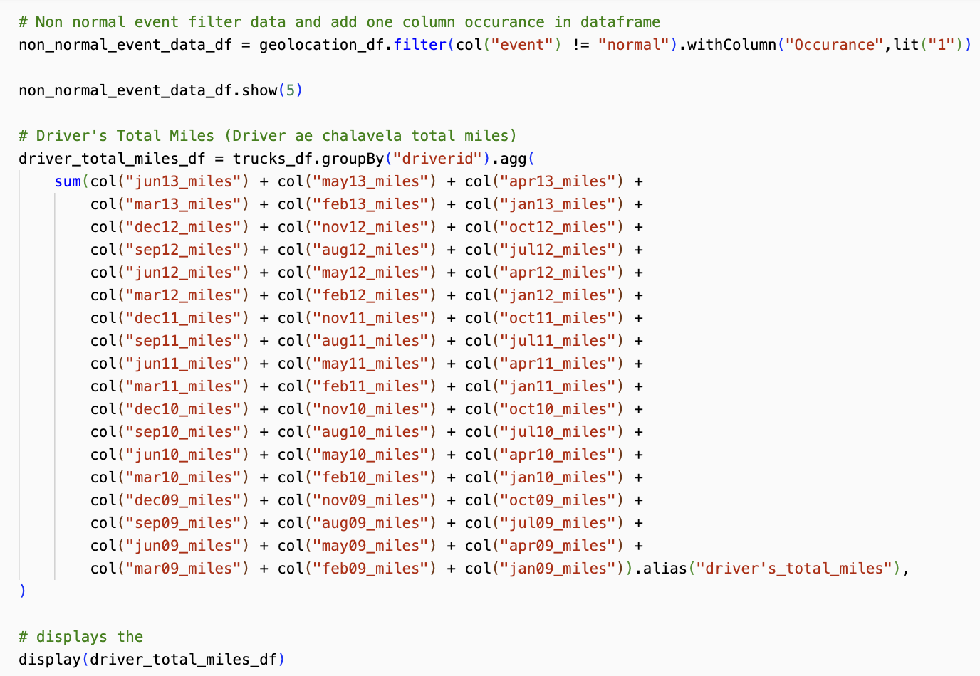
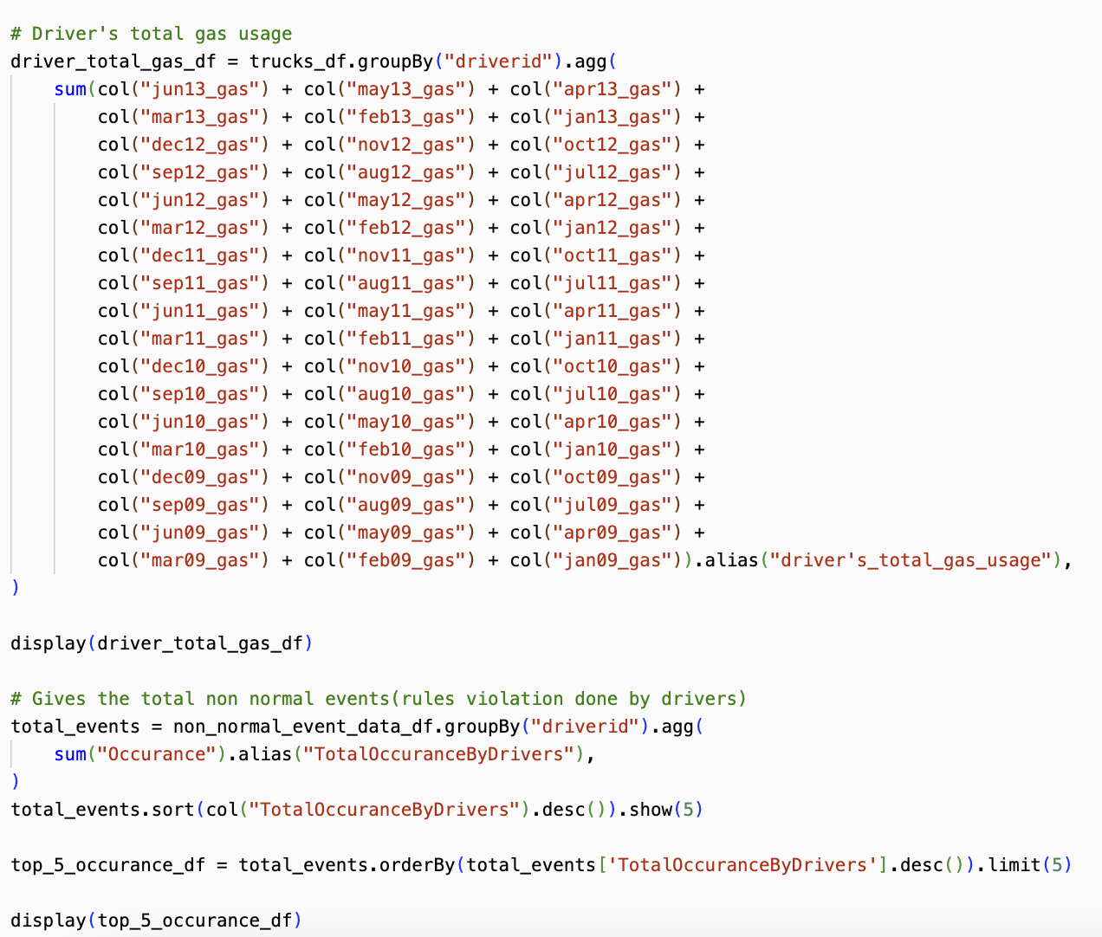
Implementation Approach

Slide 14
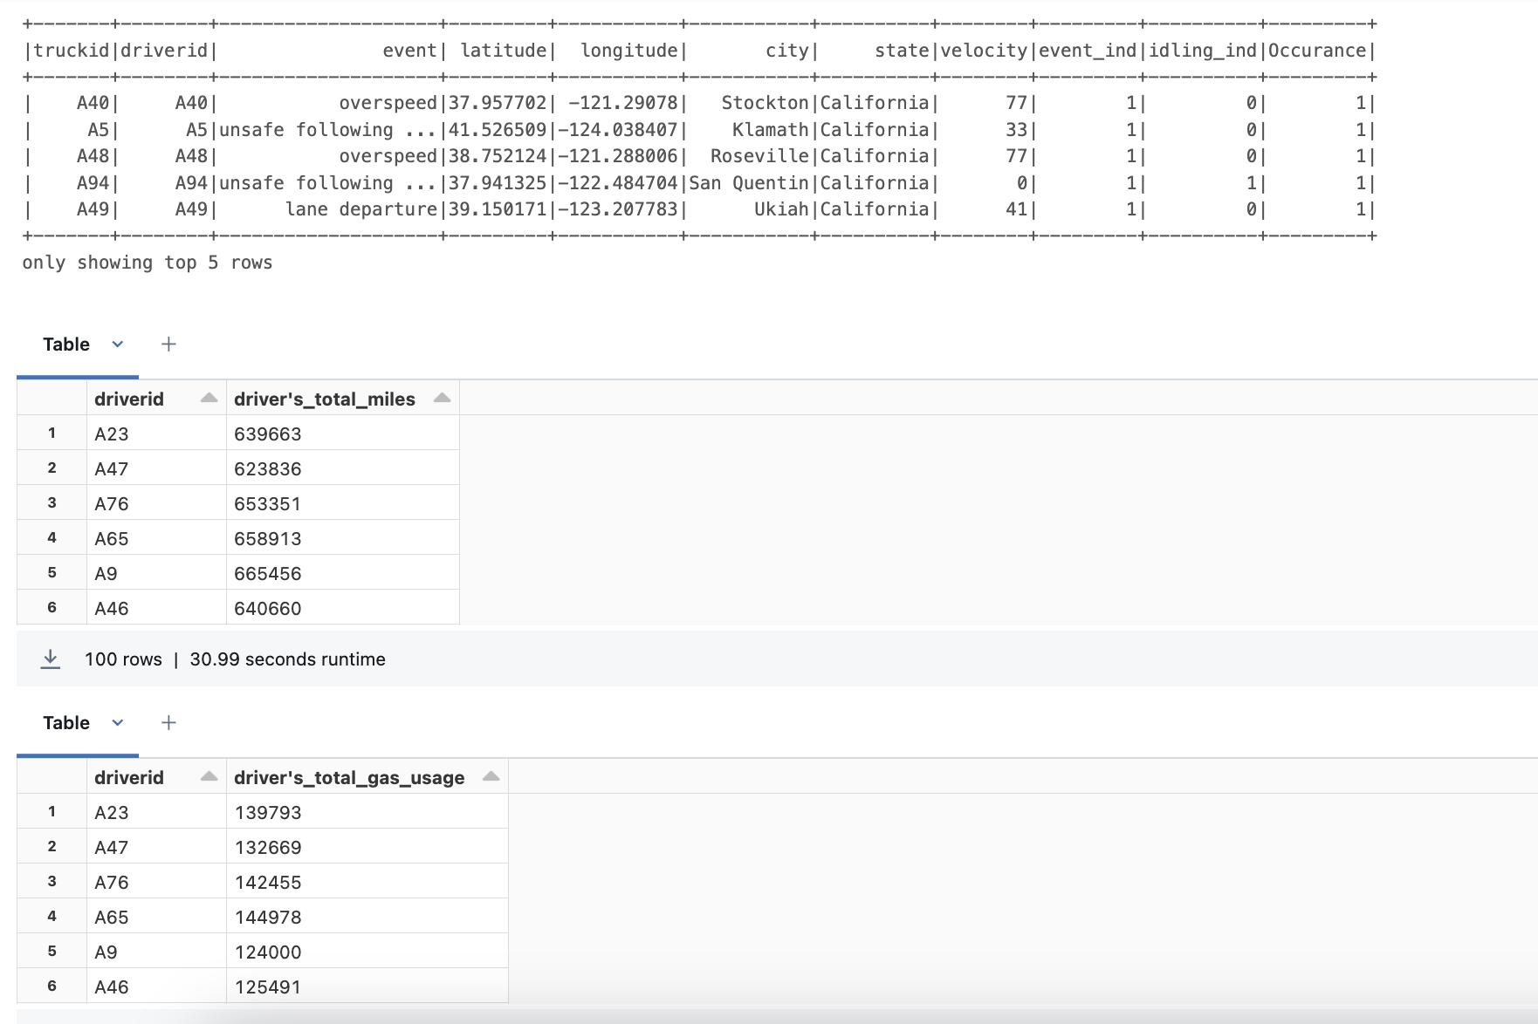
Implementation Approach

Slide 15
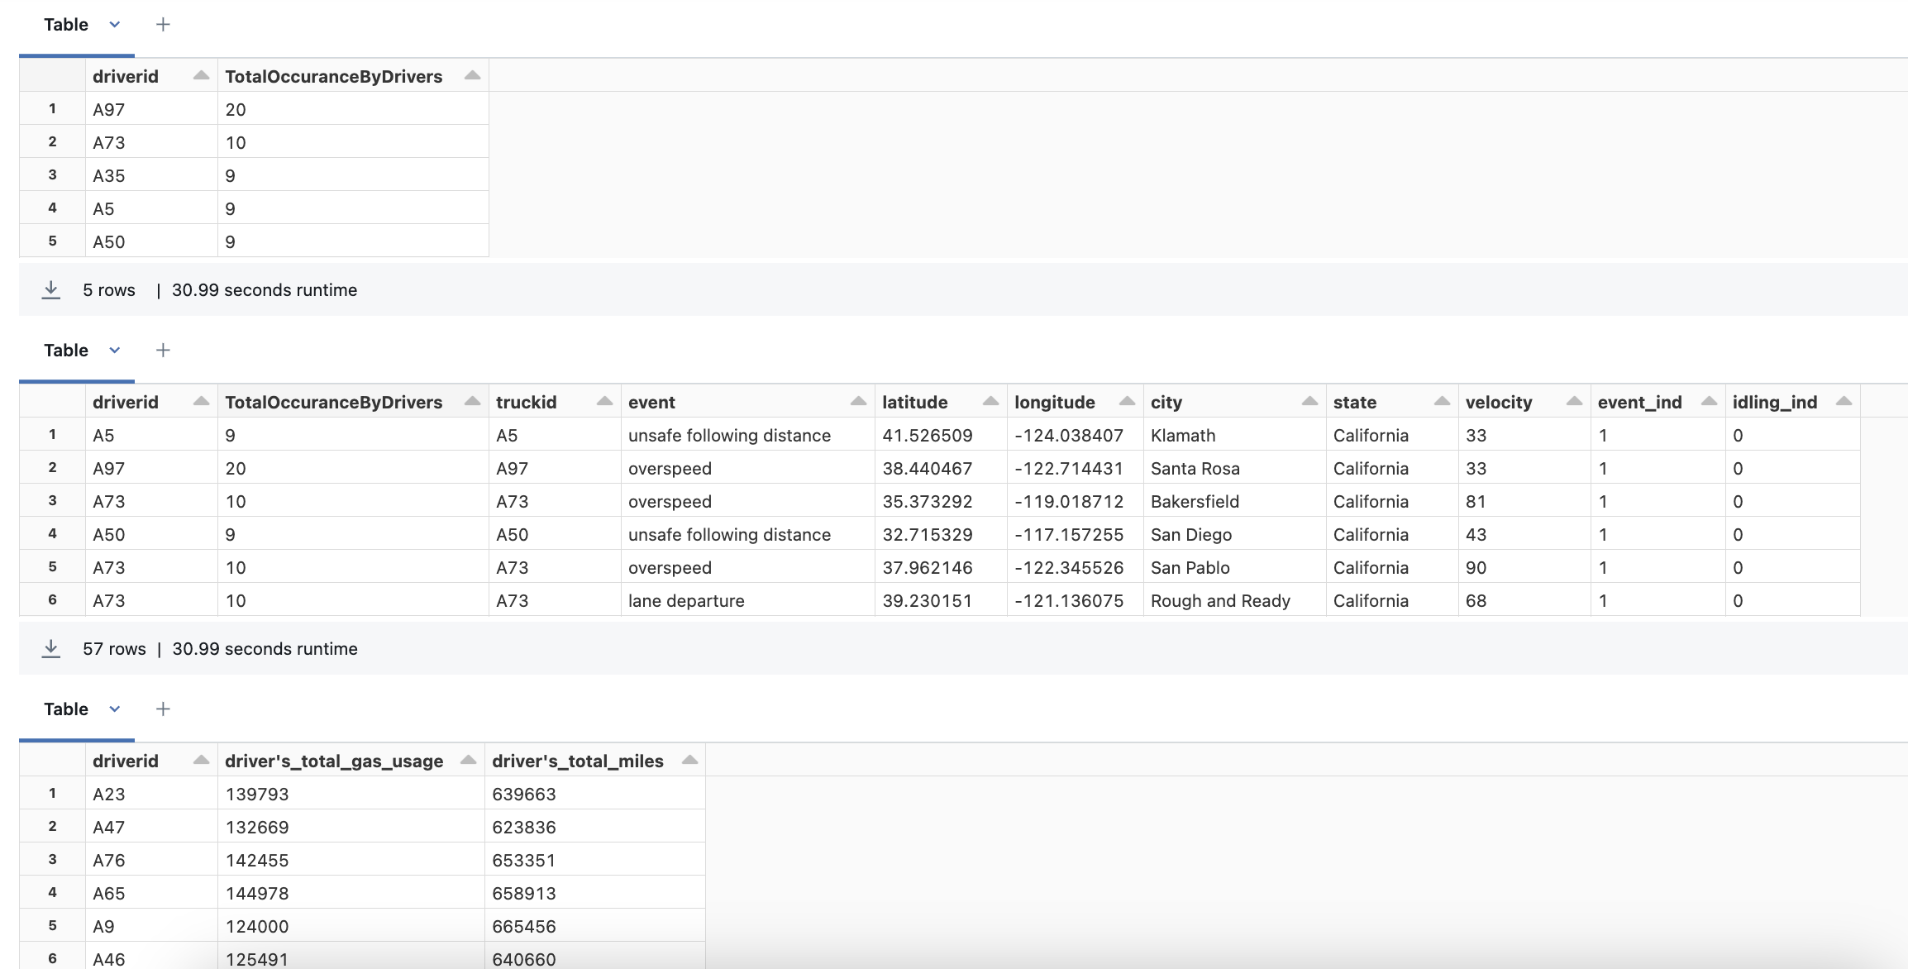
Implementation Approach

Slide 16
Discussion on Results
Driver Efficiency Scatter Plot:
Purpose: To display the fuel efficiency of drivers.
Analysis: By plotting efficiency (miles per gallon) against driver IDs, one can identify which drivers are the most fuel-efficient. This is useful for recognizing patterns of efficiency and possibly correlating them with other behaviors or attributes (like routes, vehicle types, or driving habits).
Conclusion: Drivers who consistently show higher efficiency might be considered for rewards or used as models for training less efficient drivers. Conversely, drivers with low efficiency could be targeted for additional training or vehicle maintenance checks.

Slide 17
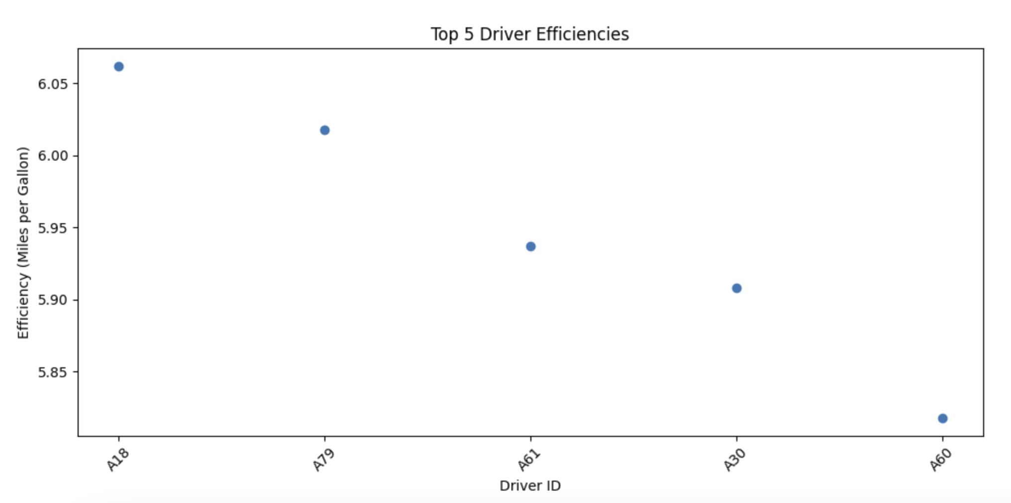
Discussion on Results

Slide 18
Discussion on Results
Event Counts Bar Plot:
Purpose: To show the frequency of various types of driving events.
Analysis: This horizontal bar plot helps in understanding which events are most common across the data set. High-frequency events might indicate common challenges or areas where driver behavior could be improved.
Conclusion: By focusing safety training and operational improvements on the most common events, the organization can potentially reduce their occurrence and improve overall safety metrics.

Slide 19
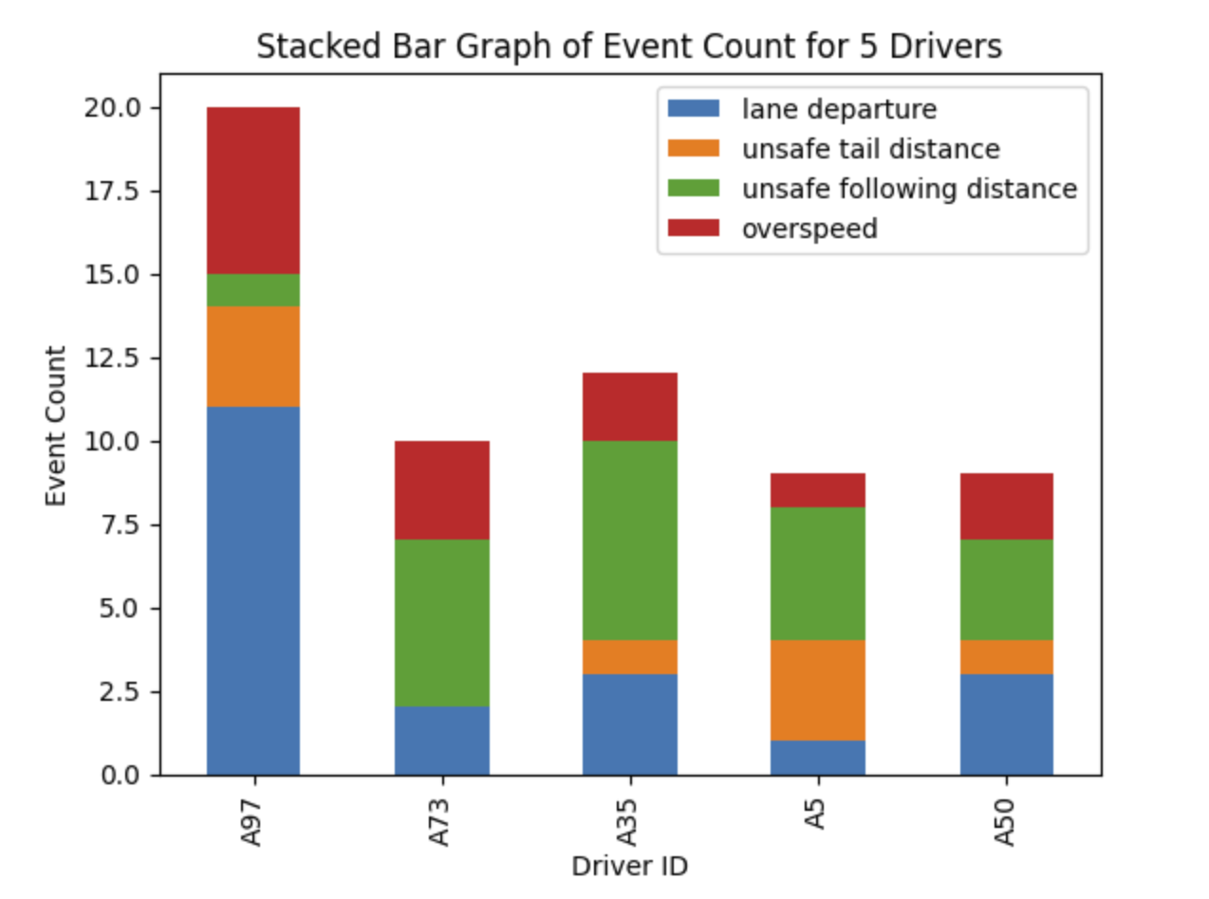
Discussion on Results

Slide 20
Discussion on Results
Events by Risky Driver Scatter Plot:
Purpose: To illustrate how often different unsafe driving events occur.
Analysis: The chart shows that over speeding is the most frequent event, followed by unsafe following and tail distances. Lane departures are less common but still concerning.
Conclusion: Addressing speeding and safe distance practices through targeted training and enhanced monitoring could significantly improve road safety.

Slide 21
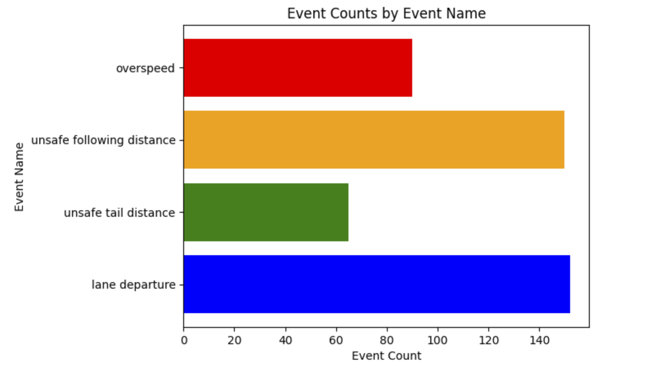
Discussion on Results

Slide 22
Discussion on Results
Top 5 Cities with Events Scatter Plot:
Purpose: To focus on urban centers with a high frequency of events.
Analysis: By pinpointing where significant events occur, particularly in urban settings, this plot provides insights into geographic and possibly urban-specific challenges (like dense traffic or complex intersections).
Conclusion: City-specific strategies, including collaboration with local traffic management authorities, could be developed to address unique challenges faced in these areas.

Slide 23
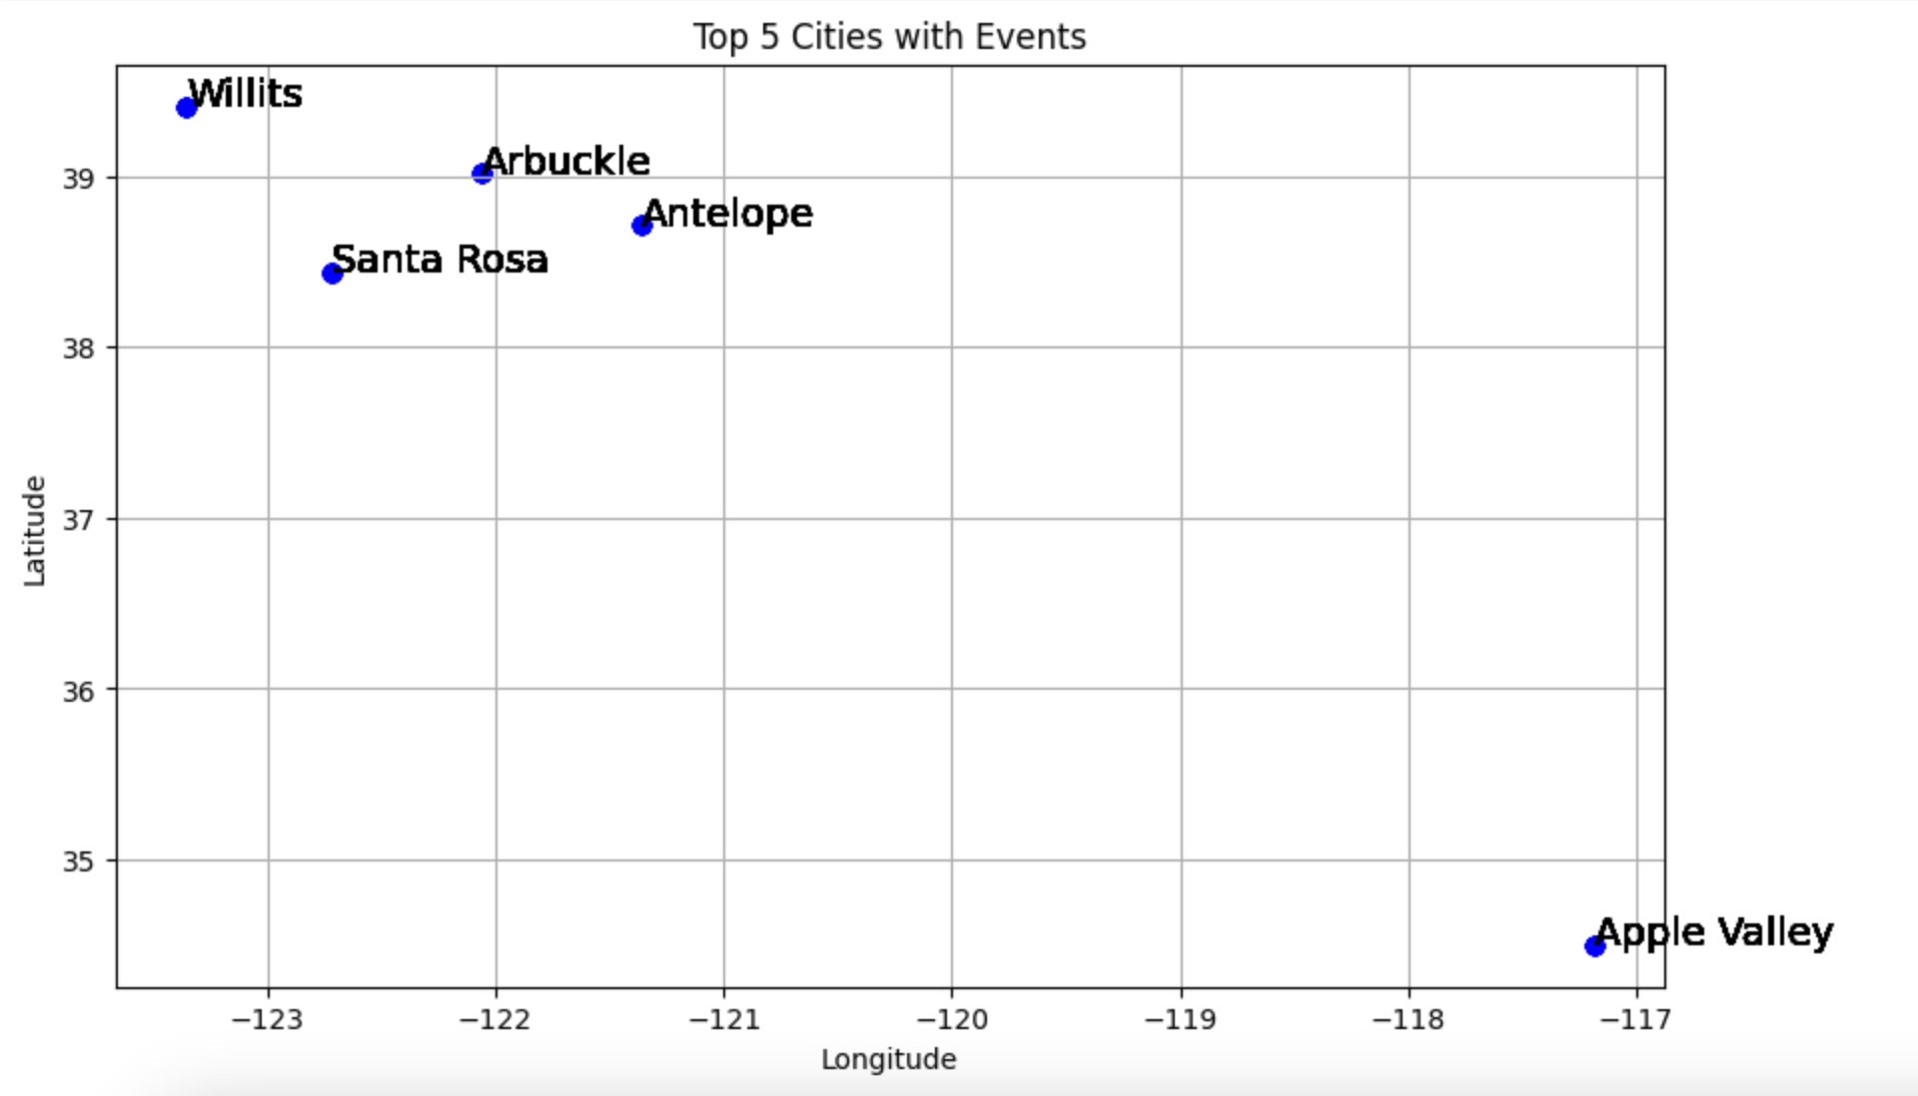
Discussion on Results

Slide 24
Discussion on Results
Top 5 Risky Drivers Line Plot:
Purpose: To rank drivers by their associated risk factors.
Analysis: A line plot showing risk factors associated with individual drivers helps in quickly identifying those who may require immediate intervention due to their high-risk profile.
Conclusion: Prioritizing interventions for these drivers could include advanced driving courses, more frequent vehicle inspections, or even behavioral counseling if needed.

Slide 25
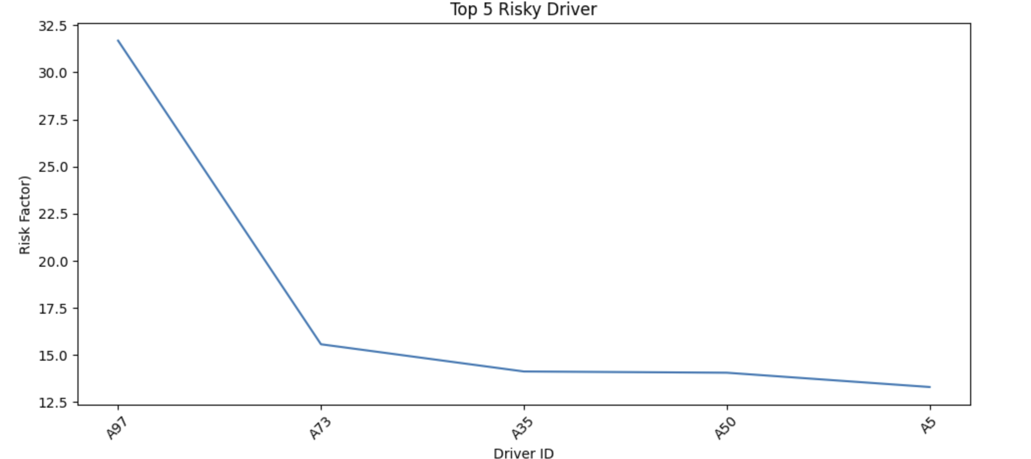
Discussion on Results

Slide 26
Conclusion
Efficiency Recognition: By evaluating driver efficiency metrics, we have pinpointed which drivers exhibit superior fuel efficiency. This insight allows for the acknowledgment of high performers and provides a benchmark to help lower-performing drivers improve, potentially leading to significant cost savings on fuel.
Safety Enhancements: Our analysis of event frequencies has highlighted over speeding and unsafe following distances as the most prevalent risky behaviors. Addressing these through targeted training and real-time monitoring can drastically reduce the occurrence of such events, thereby enhancing overall road safety.
Geographical Insights: The geographical distribution of events, particularly in urban centers, underscores the need for city-specific strategies to tackle unique driving challenges posed by dense traffic and complex road layouts. Collaboration with local traffic management authorities could be pivotal in mitigating these risks.
Risk Management: The project's ability to quantify risk through a calculated 'Risk Factor' for each driver enables targeted interventions. Drivers with high risk factors could benefit from additional safety training, frequent vehicle inspections, or behavioral counseling, contributing to a safer driving environment.

Slide 27
Thank You

